Slide 1
Copyright © 2014 Pearson Education, Inc.

Slide 2
Chapter 11
B2B E-commerce: Supply Chain Management and Collaborative Commerce
Copyright © 2014 Pearson Education, Inc.

Slide 3
Volkswagen Builds Its B2B
Platform
Why didn’t Volkswagen want to use a more open or public electronic exchange for its parts supply? Why didn’t it join an industry consortium such as Covisint?
What kinds of services are provided by VWGroupSupply?
What is eCAP and who benefits from its use?
Do you think suppliers are disadvantaged by this B2B marketplace?
Copyright © 2014 Pearson Education, Inc.
Slide 11-<number>

Slide 4
Defining B2B Commerce
Before Internet
  B2B transactions called trade or procurement process
Total inter-firm trade
  Total flow of value among firms
B2B commerce
  All types of computer-enabled inter-firm trade
B2B e-commerce
  The portion of B2B commerce enabled by the Internet
Copyright © 2014 Pearson Education, Inc.
Slide 11-<number>

Slide 5
The Evolution of B2B Commerce
Automated order-entry systems
  Seller-side solution
Electronic data interchange (EDI)
  Buyer-side solution
  Hub-and-spoke system
  Serve vertical markets
B2B electronic storefronts
Net marketplaces
Private industrial networks
Copyright © 2014 Pearson Education, Inc.
Slide 11-<number>

Slide 6
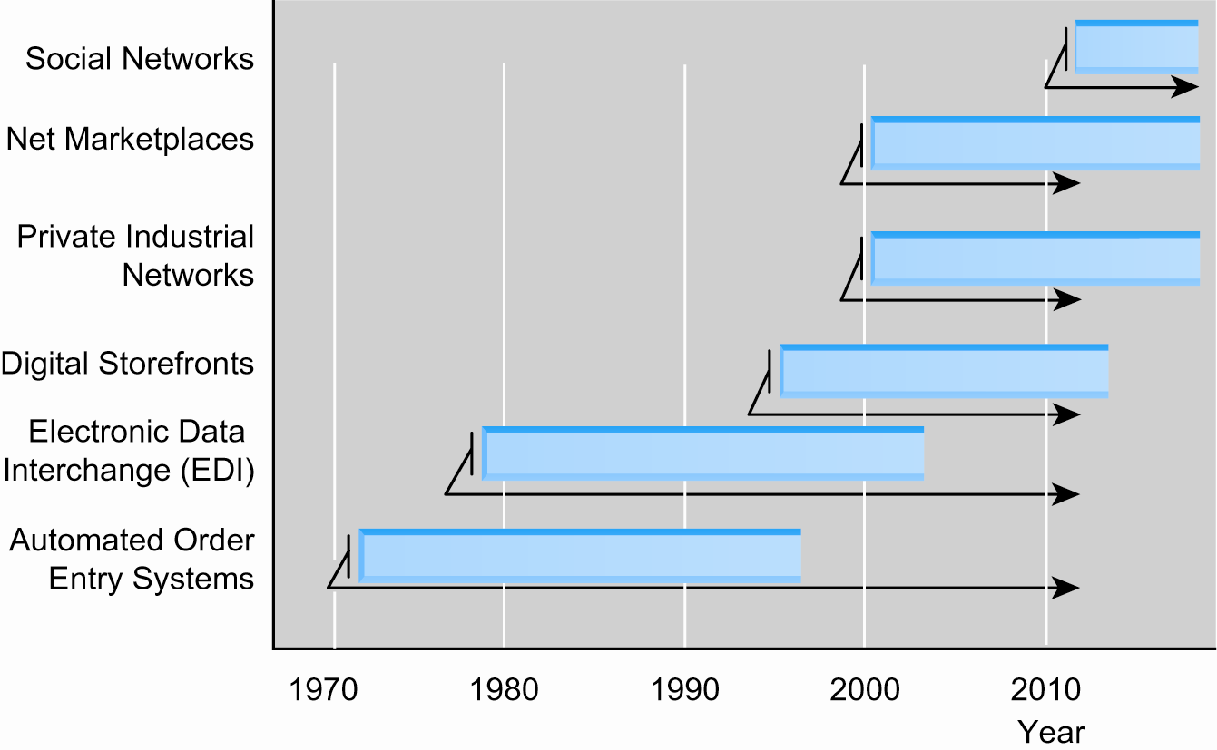
Evolution of the Use of
Technology Platforms in B2B Commerce
Figure 11.1, Page 417
Copyright © 2014 Pearson Education, Inc.
Slide 11-<number>

Slide 7
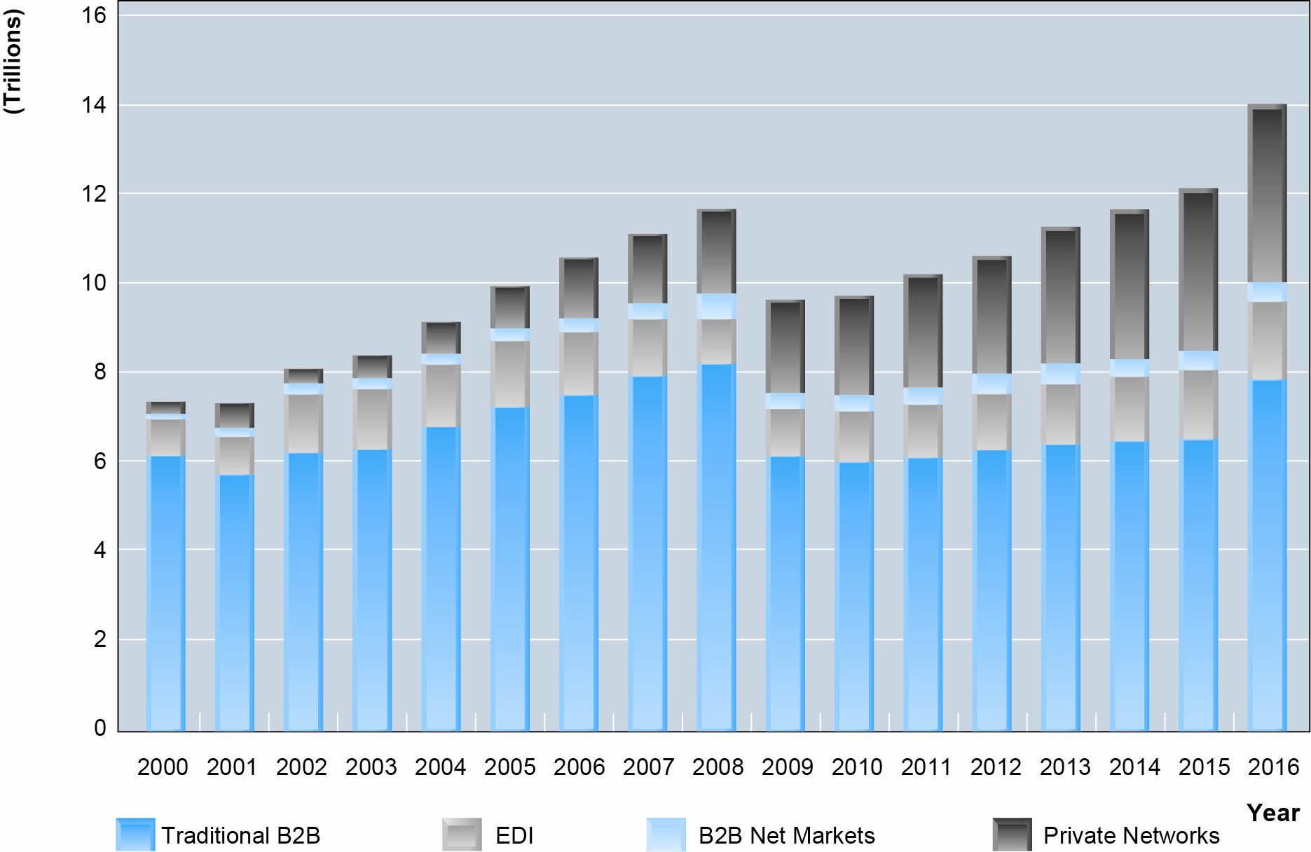
Growth of B2B Commerce 2000–2016
Figure 11.2, Page 417
SOURCES: Based on data from U.S. Census Bureau, 2012a; authors’ estimates.
Copyright © 2014 Pearson Education, Inc.
Slide 11-<number>

Slide 8
Potential Benefits of B2B E-commerce
Lower administrative costs
Lower search costs for buyers
Reduced inventory costs
  Increasing competition among suppliers
  Reducing inventory carried
Lower transaction costs
  Automation, eliminating paperwork
Increased production flexibility by ensuring just-in-time parts delivery
Copyright © 2014 Pearson Education, Inc.
Slide 11-<number>

Slide 9
Potential Benefits (cont.)
Improved quality of products by increasing cooperation among buyers and sellers
Decreased product cycle time
Increased opportunities for collaboration
Greater price transparency
Increased visibility, real-time information sharing
However, some risk is posed by increased globalization and consolidation
Copyright © 2014 Pearson Education, Inc.
Slide 11-<number>

Slide 10
Where’s My iPad: Supply Chain
Risk and Vulnerability
Why does concentrating production on fewer suppliers also concentrate risk?
How does globalization play a part in increased risk?
What types of procedures could be implemented, given increased globalization, to reduce risk?
Copyright © 2014 Pearson Education, Inc.
Slide 11-<number>

Slide 11
The Procurement Process and the Supply Chain
Procurement process
  The way firms purchase materials they need to make products
Supply chain
  Firms that purchase goods, their suppliers, and their suppliers’ suppliers, relationships and processes involved
Steps in procurement process
  Deciding who to buy from and what to pay
  Completing transaction
Copyright © 2014 Pearson Education, Inc.
Slide 11-<number>

Slide 12
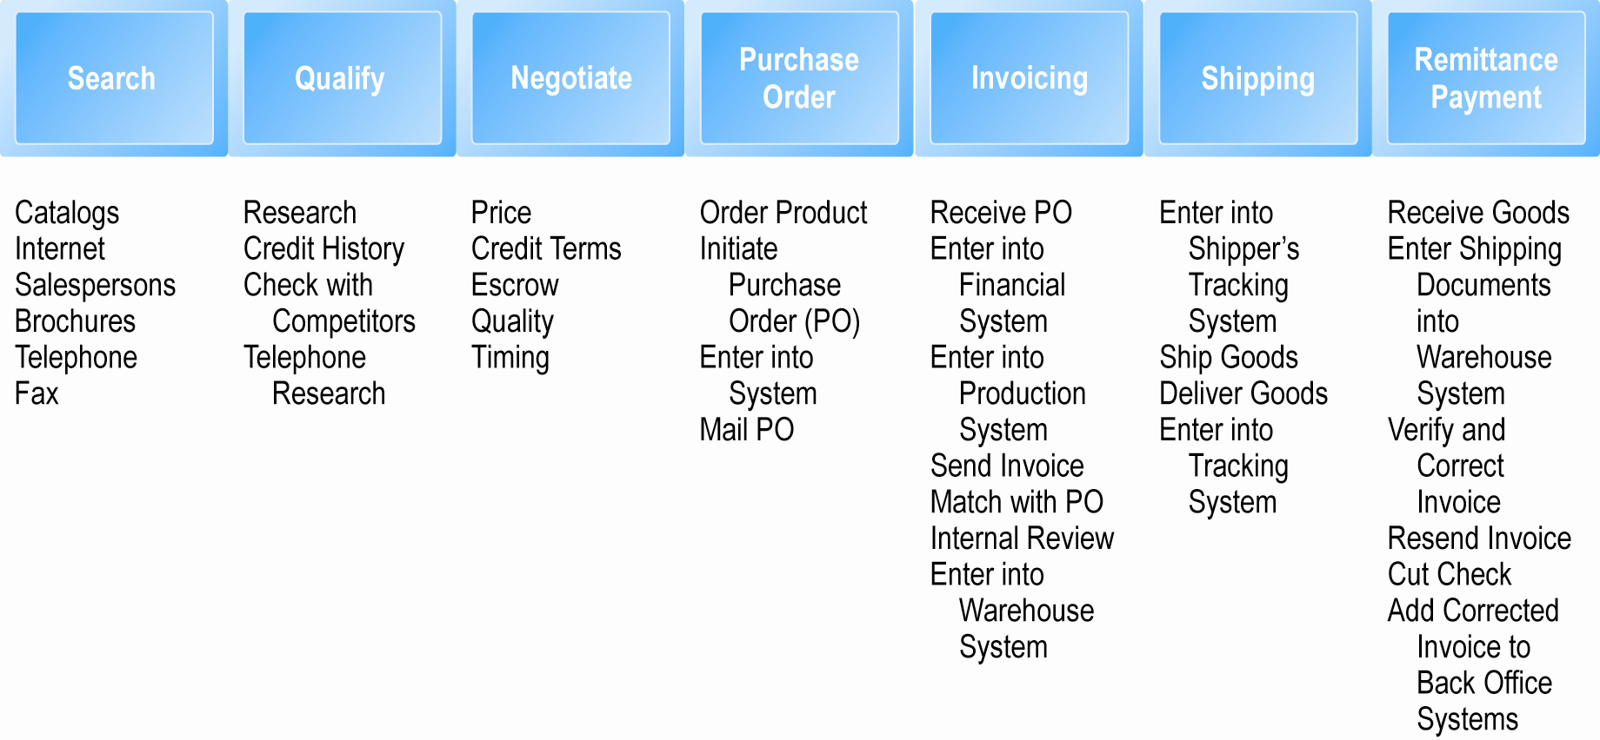
The Procurement Process
Figure 11.3, Page 421
Copyright © 2014 Pearson Education, Inc.
Slide 11-<number>

Slide 13
Types of Procurement
Firms purchase two types of goods
  Direct goods: Integrally involved in production process
  Indirect goods: All goods not directly involved in production process (MRO goods)
Firms use two methods to purchase
  Contract purchasing:
    Involves long-term written agreements to purchase specified products, with agreed-upon terms and quality
  Spot purchasing:
    Involves purchase of goods based on immediate needs in larger marketplaces that involve many suppliers
Copyright © 2014 Pearson Education, Inc.
Slide 11-<number>

Slide 14
Types of Procurement (cont.)
Multi-tier supply chain
  Complex series of transactions between firm and thousands of suppliers, supplying thousands of goods
Copyright © 2014 Pearson Education, Inc.
Slide 11-<number>

Slide 15
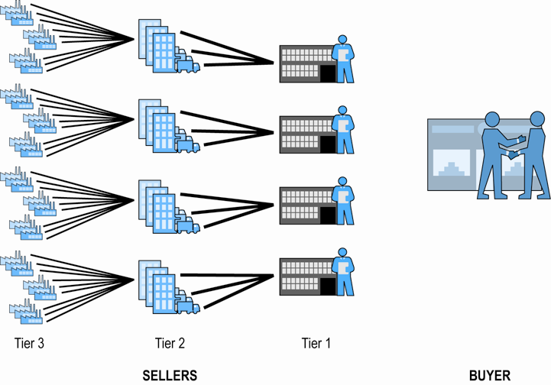
The Multi-tier Supply Chain
Figure 11.4, Page 422
Copyright © 2014 Pearson Education, Inc.
Slide 11-<number>

Slide 16
Trends in Supply Chain Management
Supply chain management (SCM)
  Activities used to coordinate key players in the procurement process
Major developments in SCM
  Just-in-time and lean production
  Supply chain simplification
  Adaptive supply chains
  Accountable supply chains
  Sustainable supply chains
  Electronic data interchange
  Supply chain management systems
  Collaborative commerce
Copyright © 2014 Pearson Education, Inc.
Slide 11-<number>

Slide 17
Just-in-Time and Lean Production
Just-in-Time production
  Method of inventory cost management
  Seeks to eliminate excess inventory to bare minimum
Lean production
  Set of production methods and tools
  Focuses on elimination of waste throughout customer value chain, not just inventory
Copyright © 2014 Pearson Education, Inc.
Slide 11-<number>

Slide 18
Supply Chain Simplification
Reducing size of supply chain
  Working with strategic group of suppliers to reduce product and administrative costs and improving quality
Essential for just-in-time production models
May involve:
  Joint product development and design
  Integration of computer systems
  Tight coupling
    Ensuring precise delivery of ordered parts at specific times
Copyright © 2014 Pearson Education, Inc.
Slide 11-<number>

Slide 19
Adaptive Supply Chains
Reducing centralization
  Reduce risks caused by relying on single suppliers who are subject to local instability
    e.g.: European financial crisis, Japanese earthquake
Creating regional or product-based supply chains
  Allowing production to be moved to temporary safe harbors in case of local manufacturing disruptions
Copyright © 2014 Pearson Education, Inc.
Slide 11-<number>

Slide 20
Accountable Supply Chains
Labor conditions in low-wage, under-developed producer countries are acceptable to consumers
  Slave/forced labor
  Child labor
  Routine exposure to toxic substances
  More than 48 hrs/week
  Harassment and abuse
  Sexual exploitation
  Adequate compensation
Copyright © 2014 Pearson Education, Inc.
Slide 11-<number>

Slide 21
Sustainable Supply Chains
Taking social and ecological interests into account
  e.g.: Water usage, air pollution
Using most efficient environment—regarding means of production, distribution, logistics
  Good business, over long-term
  Create value for consumers, investors, communities
Copyright © 2014 Pearson Education, Inc.
Slide 11-<number>

Slide 22
Electronic Data Interchange (EDI)
Broadly defined communications protocol for exchanging documents among computers
  Stage 1: 1970s–1980s—Document automation
  Stage 2: Early 1990s—Document elimination
  Stage 3: Mid-1990s—Continuous replenishment/access model
Copyright © 2014 Pearson Education, Inc.
Slide 11-<number>

Slide 23
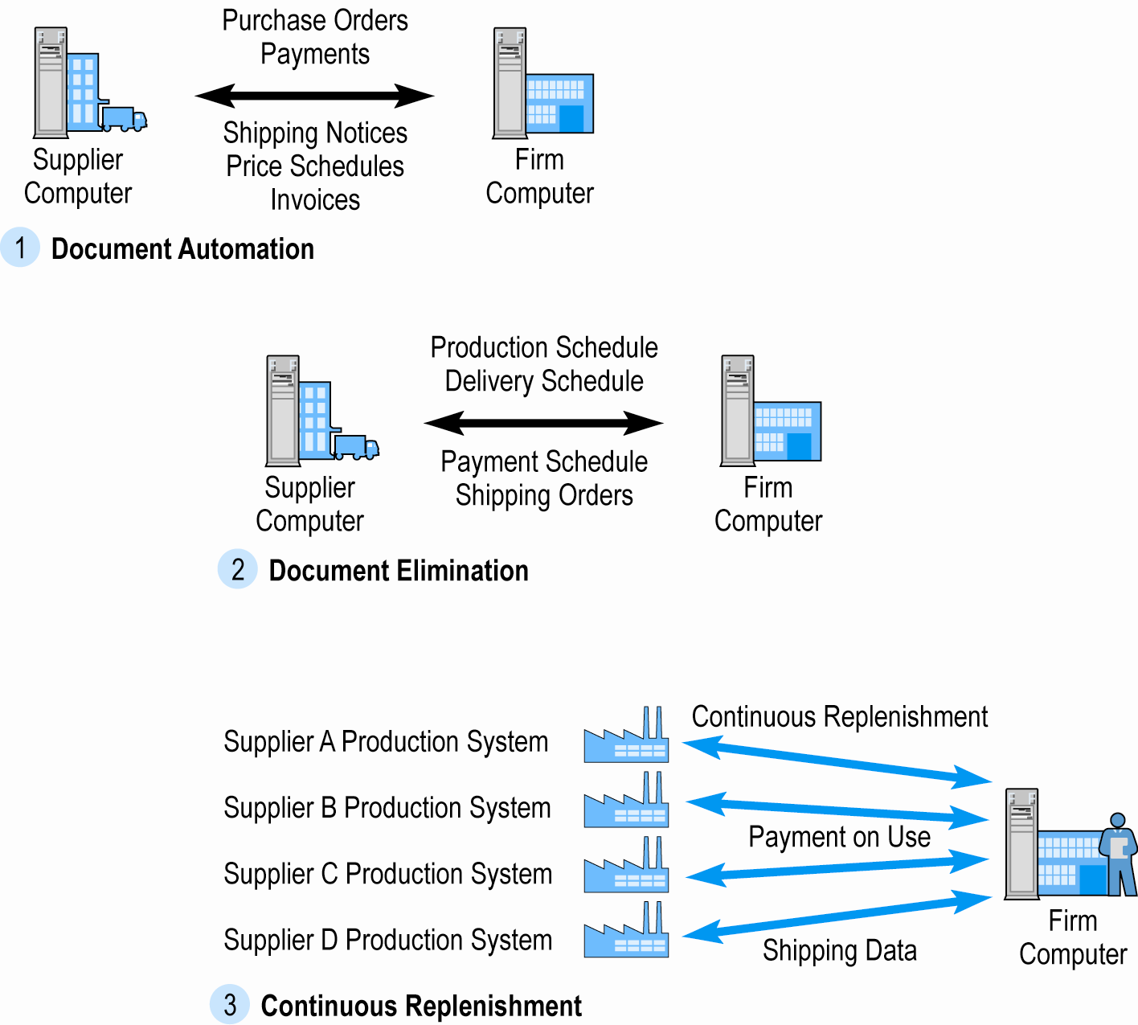
The Evolution of EDI as a B2B Medium
Figure 11.5, Page 427
Copyright © 2014 Pearson Education, Inc.
Slide 11-<number>

Slide 24
Supply Chain Management Systems
Continuously link activities of buying, making, and moving products from suppliers to purchasing firms
  SAP and Oracle Mobile apps for smartphones, tablets
Integrates demand side of business equation by including order entry system in the process
With SCM system and continuous replenishment, inventory is eliminated and production begins only when order is received
Copyright © 2014 Pearson Education, Inc.
Slide 11-<number>

Slide 25
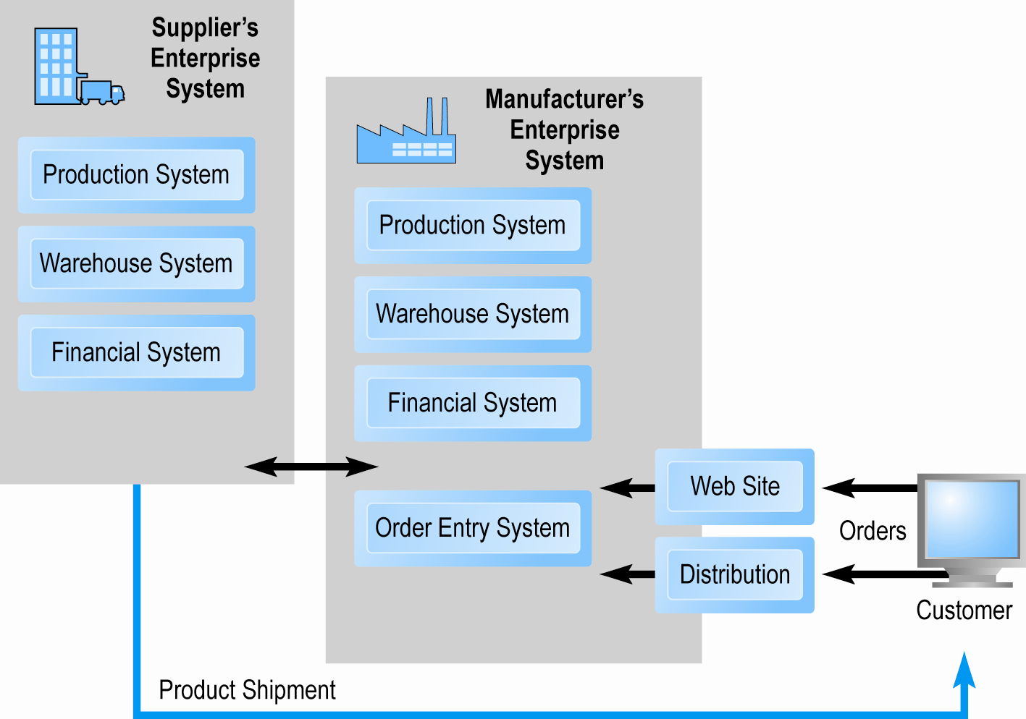
Supply Chain Management Systems
Figure 11.6, Page 428
Copyright © 2014 Pearson Education, Inc.
Slide 11-<number>

Slide 26
Collaborative Commerce
Use of digital technologies for organizations to collaboratively design, produce, and manage products through life cycles
Moves focus from transactions to relationships among supply chain participants
Unlike EDI, more like an interactive teleconference among members of supply chain
Use of Internet technologies for rich communications environment
  Sharing designs, documents, messages, network meetings, videconferencing
Copyright © 2014 Pearson Education, Inc.
Slide 11-<number>

Slide 27
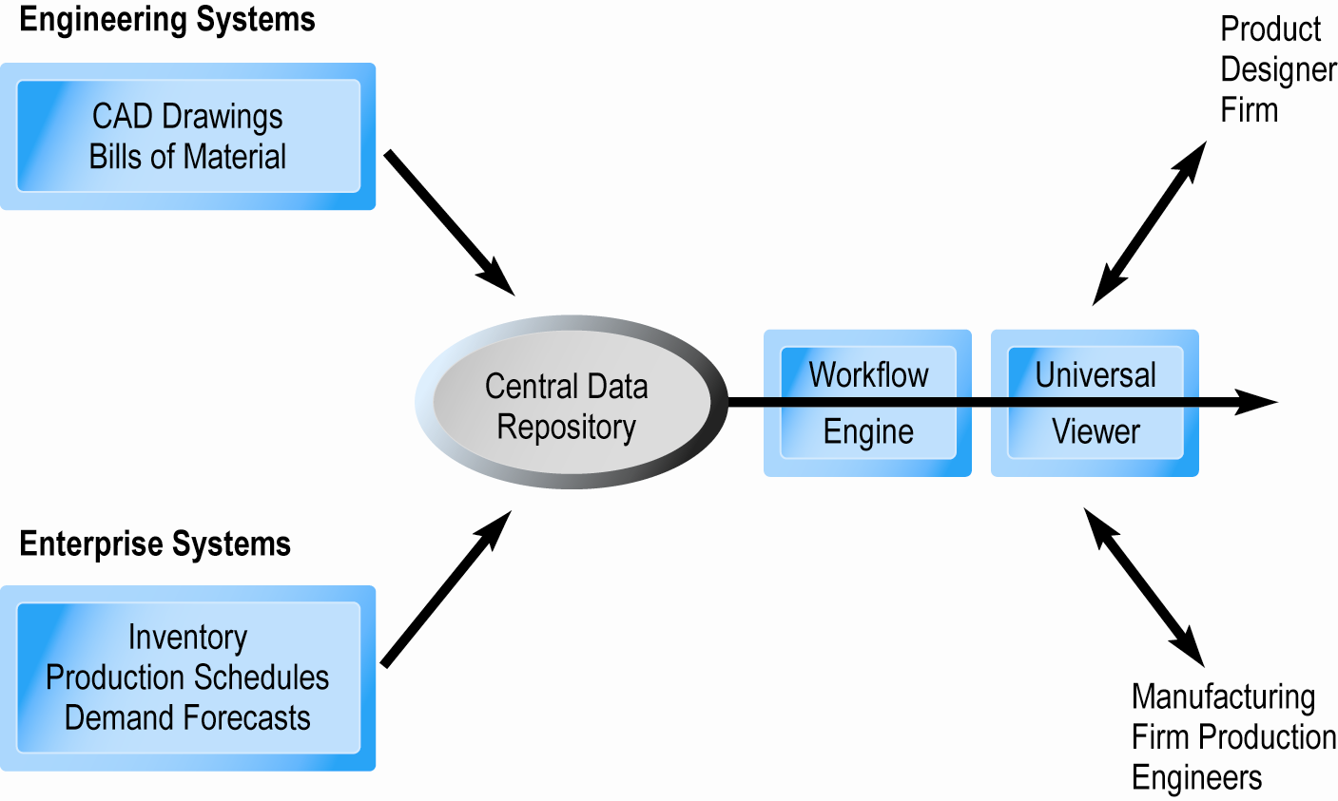
Elements of a Collaborative Commerce System
Figure 11.7, Page 429
Copyright © 2014 Pearson Education, Inc.
Slide 11-<number>

Slide 28
Social Networks and B2B
Social networks can provide personal connections that can help decision-making in supply chain
  Many supply chain networks are private
  Others on Facebook
Copyright © 2014 Pearson Education, Inc.
Slide 11-<number>

Slide 29
Two Main Types of Internet-based B2B Commerce
Net marketplaces
  Bring together potentially thousands of sellers and buyers in single digital marketplace operated over Internet
  Transaction-based
  Support many-to-many as well as one-to-many relationships
Private industrial networks
  Bring together small number of strategic business partner firms that collaborate to develop highly efficient supply chains
  Relationship-based
  Support many-to-one and many-to-few relationships
  Largest form of B2B e-commerce
Copyright © 2014 Pearson Education, Inc.
Slide 11-<number>

Slide 30
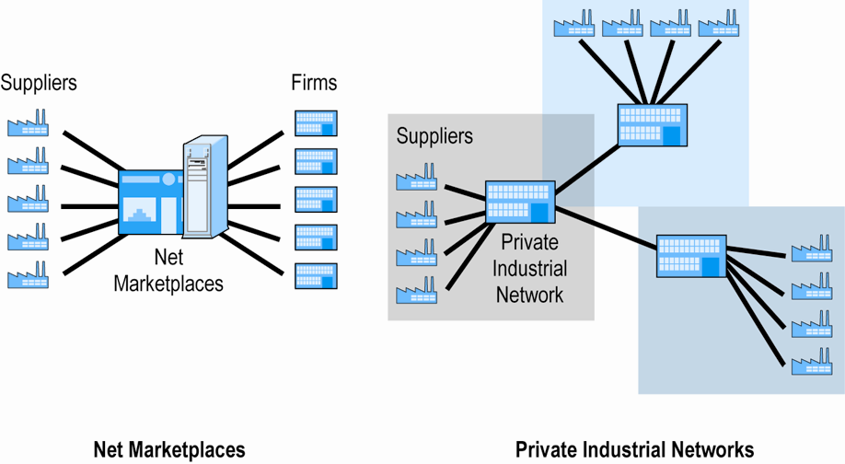
Two Main Types of Internet-based B2B Commerce
Figure 11.8, Page 430
Copyright © 2014 Pearson Education, Inc.
Slide 11-<number>

Slide 31
Net Marketplaces
Ways to classify Net marketplaces
  Pricing mechanism, nature of market served, ownership
By business functionality
  What businesses buy (direct vs. indirect goods)
  How businesses buy (spot purchasing vs. long-term sourcing)
  Four main types
    E-distributors
    E-procurement
    Exchanges
    Industry consortia
Copyright © 2014 Pearson Education, Inc.
Slide 11-<number>

Slide 32
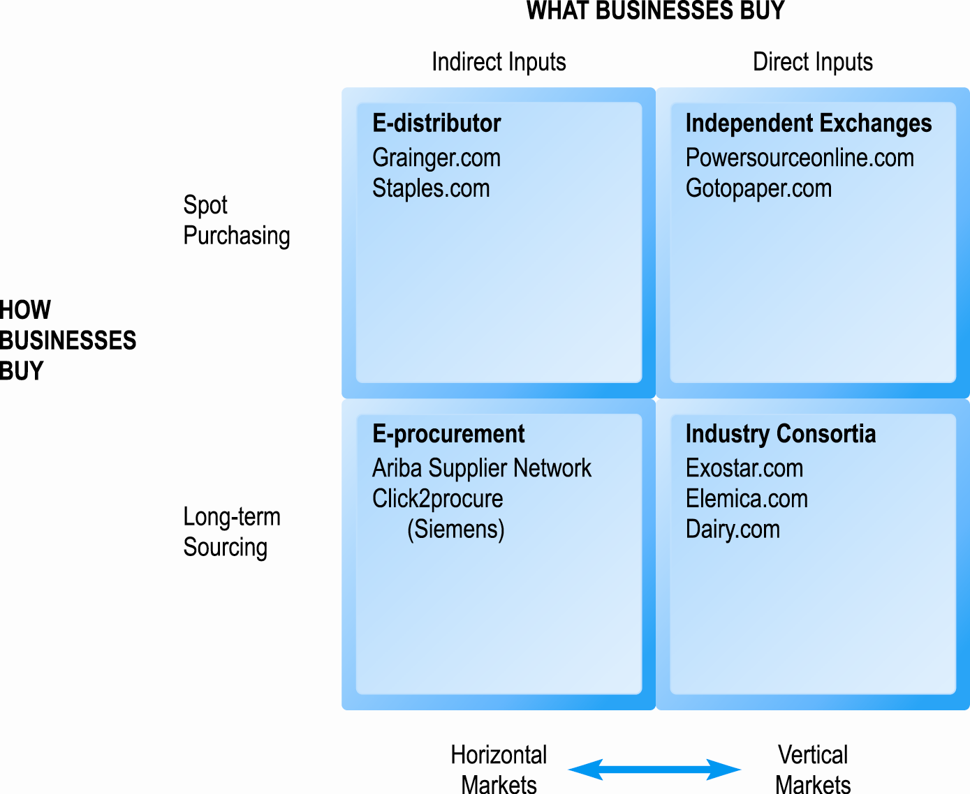
Pure Types of Net Marketplaces
Figure 11.9, Page 432
Copyright © 2014 Pearson Education, Inc.
Slide 11-<number>

Slide 33
E-distributors
Most common type of Net marketplace
Electronic catalogs representing products of thousands of direct manufacturers
Typically, independently owned intermediaries
Offer industrial customers single source to purchase indirect goods on spot basis
Typically, horizontal
Usually, fixed price—discounts for large customers
e.g.: W.W. Grainger
Copyright © 2014 Pearson Education, Inc.
Slide 11-<number>

Slide 34
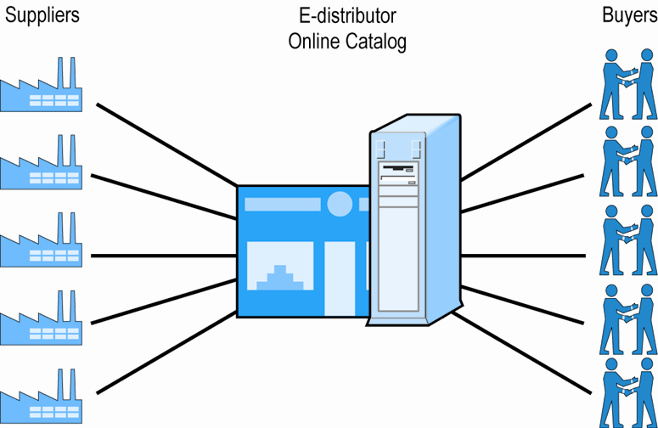
E-distributors
Figure 11.10, Page 433
Copyright © 2014 Pearson Education, Inc.
Slide 11-<number>

Slide 35
E-procurement Net Marketplaces
Independently owned intermediaries
Connect hundreds of suppliers of indirect goods
Firms pay fees to join market
Revenues from transaction fees, licensing consultation services and software, network fees
Offer value chain management (VCM) services
e.g.: Ariba
Copyright © 2014 Pearson Education, Inc.
Slide 11-<number>

Slide 36
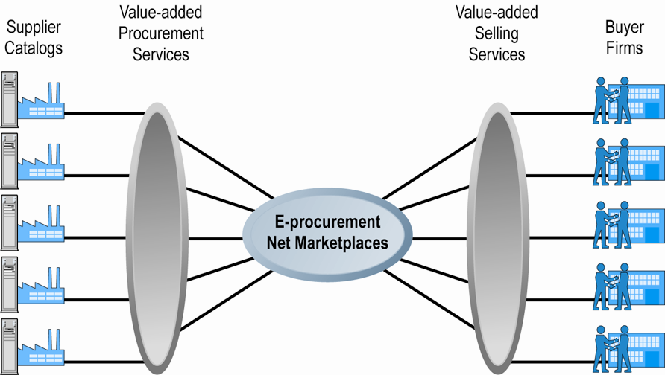
E-procurement Net Marketplaces
Figure 11.11, Page 434
Copyright © 2014 Pearson Education, Inc.
Slide 11-<number>

Slide 37
Exchanges
Independently owned online marketplaces
Connect hundreds to thousands of suppliers and buyers in dynamic, real-time environment
Vertical markets, spot purchasing in single industry
Charge commission fees on transaction
Many have failed due to low liquidity
Copyright © 2014 Pearson Education, Inc.
Slide 11-<number>

Slide 38
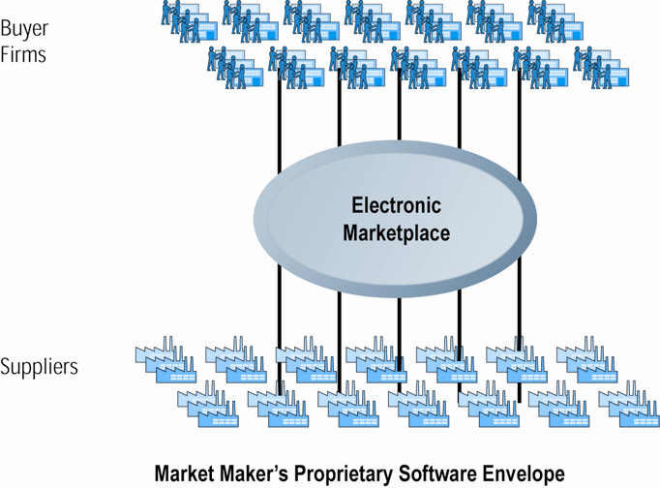
Exchanges
Figure 11.12, Page 435
Copyright © 2014 Pearson Education, Inc.
Slide 11-<number>

Slide 39
Industry Consortia
Industry-owned vertical markets
Purchase of direct inputs from set of invited participants
Emphasize long-term contractual purchasing, stable relationships, creation of data standards
Ultimate objective:
  Unification of supply chains within entire industries through common network and computing platform
Revenue from transaction and subscription fees
  Many different pricing mechanisms
Can force suppliers to use consortia’s networks
Copyright © 2014 Pearson Education, Inc.
Slide 11-<number>

Slide 40
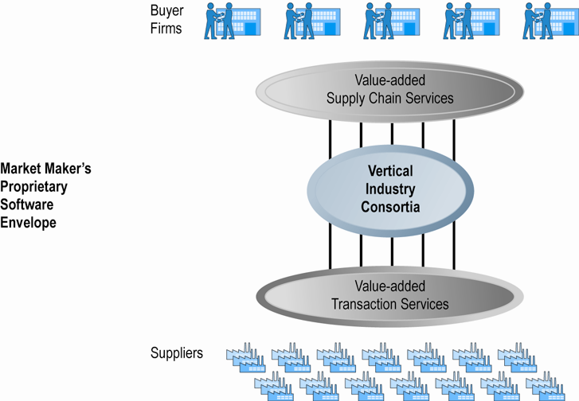
Industry Consortia
Figure 11.13, Page 437
Copyright © 2014 Pearson Education, Inc.
Slide 11-<number>

Slide 41
Private Industrial Networks
Private trading exchanges (PTXs)
Web-enabled networks for coordination of trans-organizational business processes (collaborative commerce)
  Direct descendant of EDI; closely tied to ERP systems
  Manufacturing and support industries
  Single, large manufacturing firm sponsors network
Range in scope from single firm to entire industry
e.g.: Procter & Gamble
Copyright © 2014 Pearson Education, Inc.
Slide 11-<number>

Slide 42
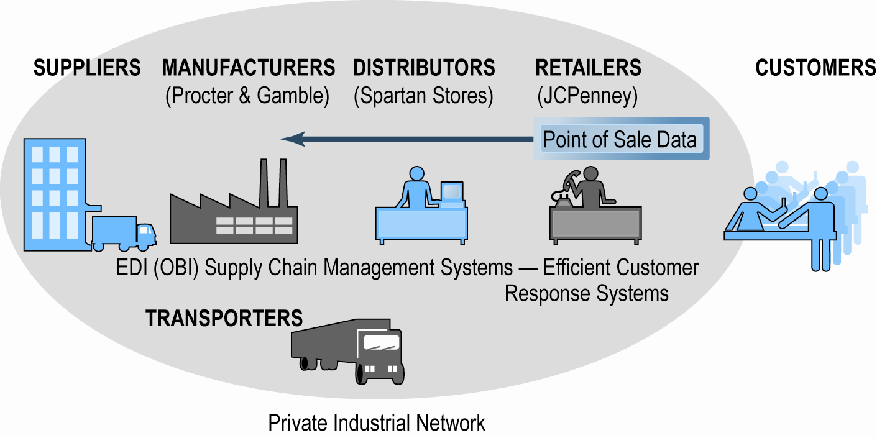
P&G’s Private Industrial Network
Figure 11.14, Page 439
Copyright © 2014 Pearson Education, Inc.
Slide 11-<number>

Slide 43
Walmart Develops a
Private Industrial Network
What is Walmart’s Retail Link system and how has it changed since the early 1990s?
Why is Walmart still using EDI-based systems?
Why won’t Walmart join in an industry-backed system?
How can other companies compete with Walmart?
Copyright © 2014 Pearson Education, Inc.
Slide 11-<number>

Slide 44
Private Industrial Networks and Collaborative Commerce
Forms of collaboration
  Collaborative resource planning, forecasting, and replenishment (CPFR)
    Working with network members to forecast demand, develop production plans, and coordinate shipping, warehousing and stocking activities to ensure that retail and wholesale shelf space is replenished with just the right amount of goods
  Demand chain visibility
  Marketing coordination and product design
    Can ensure products fulfill claims of marketing
    Feedback enables closed loop marketing
Copyright © 2014 Pearson Education, Inc.
Slide 11-<number>

Slide 45
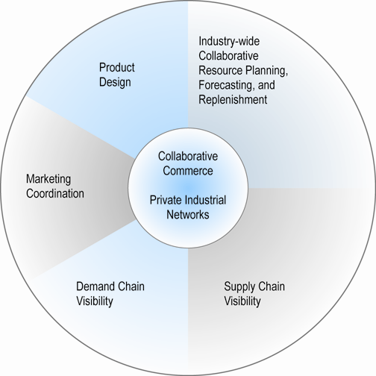
Pieces of the Collaborative
Commerce Puzzle
Figure 11.15, Page 441
Copyright © 2014 Pearson Education, Inc.
Slide 11-<number>

Slide 46

Copyright © 2014 Pearson Education, Inc.
Slide 11-<number>

